Slide 1
Solving: Interface Method Access in C#

Slide 2
Problem Overview
An interface IAttendance with MarkAttendance()
An abstract class Staff
Two derived classes: PermanentStaff and ContractStaff
Each implements IAttendance and overrides CalculateSalary()
Call MarkAttendance() on all staff in a List<Staff>

Slide 3
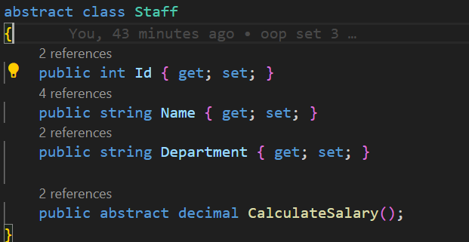

Slide 4
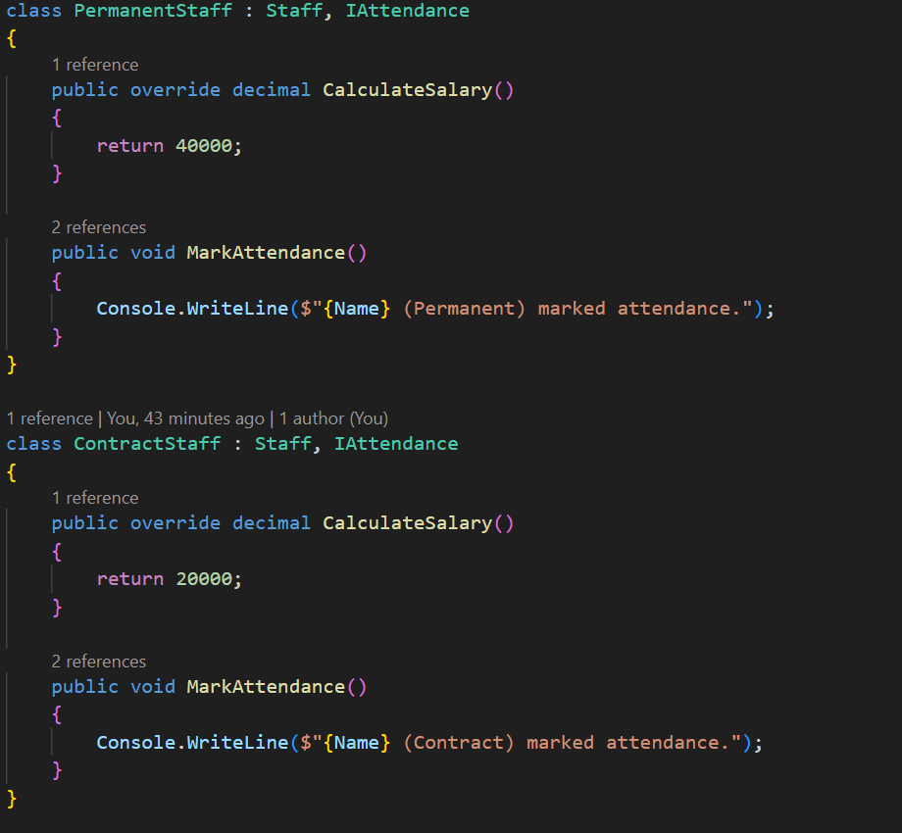

Slide 5
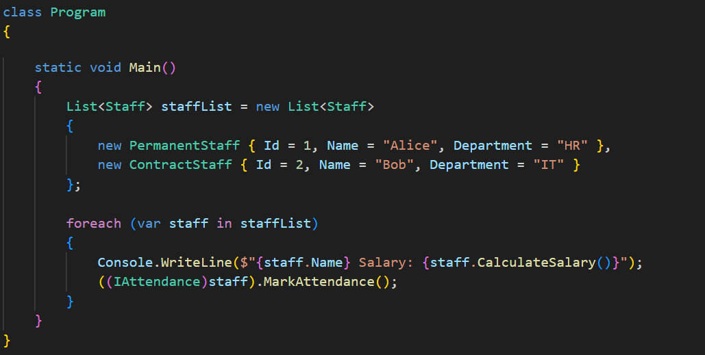

Slide 6
Why Can't We Call MarkAttendance() Directly?
Inside foreach (var staff in staffList),
the object type is Staff.
Staff doesn't implement IAttendance, so:
staff.MarkAttendance() => Compile Error

Slide 7
Solution: Cast to Interface
Cast the staff object to IAttendance to access the method:
((IAttendance)staff).MarkAttendance();
This works because the actual object is of a derived type
that does implement IAttendance.

Slide 8
Thank You

